Slide 1
Query Analysis and Tuning

Slide 2
Agenda
Overview of query execution concepts
Obtaining SQL from DQL
Obtaining and influencing the execution plan in Oracle
Obtaining and influencing the execution plan in SQL Server
Identifying and indexing key SDT data

Slide 3
Query Execution Concepts
Optimizer
The query processing engine in the RDBMS that determines the most efficient method of satisfying a request
Considers CPU cost and logical/physical I/O for each access path and join method
Choices are influenced by:
the SQL statement
Database design (available indexes, partitioning)
Hints
Optimization level or goal
Statistics and histograms
Configuration parameters
Environment
Execution plan
The final series of steps selected by the optimizer
Access paths
Join methods
Join order

Slide 4
Access Paths and Join Methods
Access paths
Full table scan
Table access after using indexes to find matching values
Index lookup only
Join methods
Nested loops
Sort Merge join
Hash join
Index join
Cartesian join

Slide 5
Obtaining the SQL from DQL
Identify the DQL that needs further analysis
**** QUERY RESPONSE SORTED IN DESCENDING ORDER ****
qry rsp query
0.984 SELECT w.a_wq_name as queue_name, w.r_runtime_state as runtime_state, w.r_performer_name as performer_name, count(w.r_object_id) as task_state_count, max(w.r_priority) as task_max_priority from dmi_workitem w, dm_workflow wf where w.r_runtime_state in (0, 1, 3, 4, 5, 6) and wf.r_runtime_state in (1, 3) and ( w.a_wq_name in (SELECT w.wq_name FROM dmc_workqueue w, dmc_workqueue_policy p WHERE w.wq_policy_id = p.r_object_id)) and w.r_workflow_id = wf.r_object_id group by w.a_wq_name, w.r_runtime_state, w.r_performer_name order by w.a_wq_name, w.r_runtime_state
0.938 select g.group_name as group_name, count(*) as group_count from dm_group g, dm_user u where u.workflow_disabled = 0 and any i_all_users_names = u.user_name and ( g.group_name in (SELECT w.wq_name FROM dmc_workqueue w, dmc_workqueue_policy p WHERE w.wq_policy_id = p.r_object_id)) group by g.group_name
0.735 select g.group_name as group_name, count(*) as group_count from dm_group g, dm_user u where u.workflow_disabled = 0 and any i_all_users_names = u.user_name and ( g.group_name in (SELECT w.wq_name FROM dmc_workqueue w, dmc_workqueue_policy p WHERE w.wq_policy_id = p.r_object_id)) group by g.group_name
0.563 select g.group_name as group_name, count(*) as group_count from dm_group g, dm_user u where u.workflow_disabled = 0 and any i_all_users_names = u.user_name and ( g.group_name in (SELECT w.wq_name FROM dmc_workqueue w, dmc_workqueue_policy p WHERE w.wq_policy_id = p.r_object_id)) group by g.group_name

Slide 6
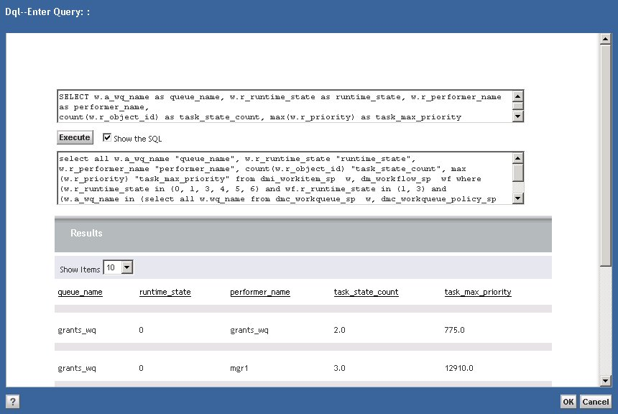
Obtaining the SQL from the DQL
Use DA DQL Editor
enable “Show the SQL” checkbox
Text area has a size limitation so the query may be cut off
In iapi:
SQL_TRACE utility (to session logs):
API> trace,c,1,,SQL_TRACE
API> ?,c,<command>
API> trace,c,0,,SQL_TRACE
GET_LAST_SQL (to screen)
API> ?,c,<command>
API> ?,c,EXECUTE GET_LAST_SQL
Important: Run the DQL as the user who is experiencing issues

Slide 7
Interpreting an Execution Plan
The execution plan provides information about:
Access paths
Full table scan, index range scan, full index scan etc.
Join methods
Nested loops, sort-merge
Join order
Small to large?
Filter criteria
Filter on index or table data?
Cost of each step
Relative estimate of resources consumed

Slide 8
Sample execution plan using “autotrace”
Execution Plan
----------------------------------------------------------
Plan hash value: 1237547910
-----------------------------------------------------------------------------------------------------
| Id | Operation | Name | Rows | Bytes | Cost (%CPU)| Time |
-----------------------------------------------------------------------------------------------------
| 0 | SELECT STATEMENT | | 17 | 1292 | 21 (15)| 00:00:01 |
| 1 | SORT GROUP BY | | 17 | 1292 | 21 (15)| 00:00:01 |
|* 2 | HASH JOIN | | 354 | 26904 | 20 (10)| 00:00:01 |
| 3 | NESTED LOOPS | | | | | |
| 4 | NESTED LOOPS | | 354 | 19824 | 10 (10)| 00:00:01 |
| 5 | VIEW | VW_NSO_1 | 1 | 10 | 4 (0)| 00:00:01 |
| 6 | HASH UNIQUE | | 1 | 44 | | |
| 7 | NESTED LOOPS | | 1 | 44 | 4 (0)| 00:00:01 |
| 8 | TABLE ACCESS FULL | DMC_WORKQUEUE_S | 1 | 27 | 3 (0)| 00:00:01 |
|* 9 | INDEX UNIQUE SCAN | D_1F94483B800001E3 | 1 | 17 | 1 (0)| 00:00:01 |
|* 10 | INDEX RANGE SCAN | D_1F94483B8000004E | 990 | | 1 (0)| 00:00:01 |
|* 11 | TABLE ACCESS BY INDEX ROWID| DMI_WORKITEM_S | 354 | 16284 | 5 (0)| 00:00:01 |
|* 12 | TABLE ACCESS FULL | DM_WORKFLOW_S | 1010 | 20200 | 9 (0)| 00:00:01 |
-----------------------------------------------------------------------------------------------------

Slide 9
Sample execution plan using “autotrace”
Execution Plan
----------------------------------------------------------
Plan hash value: 1237547910
-----------------------------------------------------------------------------------------------------
| Id | Operation | Name | Rows | Bytes | Cost (%CPU)| Time |
-----------------------------------------------------------------------------------------------------
| 0 | SELECT STATEMENT | | 17 | 1292 | 21 (15)| 00:00:01 |
| 1 | SORT GROUP BY | | 17 | 1292 | 21 (15)| 00:00:01 |
|* 2 | HASH JOIN | | 354 | 26904 | 20 (10)| 00:00:01 |
| 3 | NESTED LOOPS | | | | | |
| 4 | NESTED LOOPS | | 354 | 19824 | 10 (10)| 00:00:01 |
| 5 | VIEW | VW_NSO_1 | 1 | 10 | 4 (0)| 00:00:01 |
| 6 | HASH UNIQUE | | 1 | 44 | | |
| 7 | NESTED LOOPS | | 1 | 44 | 4 (0)| 00:00:01 |
| 8 | TABLE ACCESS FULL | DMC_WORKQUEUE_S | 1 | 27 | 3 (0)| 00:00:01 |
|* 9 | INDEX UNIQUE SCAN | D_1F94483B800001E3 | 1 | 17 | 1 (0)| 00:00:01 |
|* 10 | INDEX RANGE SCAN | D_1F94483B8000004E | 990 | | 1 (0)| 00:00:01 |
|* 11 | TABLE ACCESS BY INDEX ROWID| DMI_WORKITEM_S | 354 | 16284 | 5 (0)| 00:00:01 |
|* 12 | TABLE ACCESS FULL | DM_WORKFLOW_S | 1010 | 20200 | 9 (0)| 00:00:01 |
-----------------------------------------------------------------------------------------------------
Notes:
In the first step, the dmc_workqueue_s table is read using a full table scan.
Using a nested loops join, it joins each row to the unique index ending in 1E3.

Slide 10
Sample execution plan using “autotrace”
Execution Plan
----------------------------------------------------------
Plan hash value: 1237547910
-----------------------------------------------------------------------------------------------------
| Id | Operation | Name | Rows | Bytes | Cost (%CPU)| Time |
-----------------------------------------------------------------------------------------------------
| 0 | SELECT STATEMENT | | 17 | 1292 | 21 (15)| 00:00:01 |
| 1 | SORT GROUP BY | | 17 | 1292 | 21 (15)| 00:00:01 |
|* 2 | HASH JOIN | | 354 | 26904 | 20 (10)| 00:00:01 |
| 3 | NESTED LOOPS | | | | | |
| 4 | NESTED LOOPS | | 354 | 19824 | 10 (10)| 00:00:01 |
| 5 | VIEW | VW_NSO_1 | 1 | 10 | 4 (0)| 00:00:01 |
| 6 | HASH UNIQUE | | 1 | 44 | | |
| 7 | NESTED LOOPS | | 1 | 44 | 4 (0)| 00:00:01 |
| 8 | TABLE ACCESS FULL | DMC_WORKQUEUE_S | 1 | 27 | 3 (0)| 00:00:01 |
|* 9 | INDEX UNIQUE SCAN | D_1F94483B800001E3 | 1 | 17 | 1 (0)| 00:00:01 |
|* 10 | INDEX RANGE SCAN | D_1F94483B8000004E | 990 | | 1 (0)| 00:00:01 |
|* 11 | TABLE ACCESS BY INDEX ROWID| DMI_WORKITEM_S | 354 | 16284 | 5 (0)| 00:00:01 |
|* 12 | TABLE ACCESS FULL | DM_WORKFLOW_S | 1010 | 20200 | 9 (0)| 00:00:01 |
-----------------------------------------------------------------------------------------------------
Notes:
The HASH unique step is used when looking for unique or distinct values, so the results of the nested loops are interrogated and duplicate results are removed.

Slide 11
Sample execution plan using “autotrace”
Execution Plan
----------------------------------------------------------
Plan hash value: 1237547910
-----------------------------------------------------------------------------------------------------
| Id | Operation | Name | Rows | Bytes | Cost (%CPU)| Time |
-----------------------------------------------------------------------------------------------------
| 0 | SELECT STATEMENT | | 17 | 1292 | 21 (15)| 00:00:01 |
| 1 | SORT GROUP BY | | 17 | 1292 | 21 (15)| 00:00:01 |
|* 2 | HASH JOIN | | 354 | 26904 | 20 (10)| 00:00:01 |
| 3 | NESTED LOOPS | | | | | |
| 4 | NESTED LOOPS | | 354 | 19824 | 10 (10)| 00:00:01 |
| 5 | VIEW | VW_NSO_1 | 1 | 10 | 4 (0)| 00:00:01 |
| 6 | HASH UNIQUE | | 1 | 44 | | |
| 7 | NESTED LOOPS | | 1 | 44 | 4 (0)| 00:00:01 |
| 8 | TABLE ACCESS FULL | DMC_WORKQUEUE_S | 1 | 27 | 3 (0)| 00:00:01 |
|* 9 | INDEX UNIQUE SCAN | D_1F94483B800001E3 | 1 | 17 | 1 (0)| 00:00:01 |
|* 10 | INDEX RANGE SCAN | D_1F94483B8000004E | 990 | | 1 (0)| 00:00:01 |
|* 11 | TABLE ACCESS BY INDEX ROWID| DMI_WORKITEM_S | 354 | 16284 | 5 (0)| 00:00:01 |
|* 12 | TABLE ACCESS FULL | DM_WORKFLOW_S | 1010 | 20200 | 9 (0)| 00:00:01 |
-----------------------------------------------------------------------------------------------------
Notes:
Next, Oracle creates an intermediate view of the distinct results.
It then joins those results to the next table using an index on the join column.

Slide 12
Sample execution plan using “autotrace”
Execution Plan
----------------------------------------------------------
Plan hash value: 1237547910
-----------------------------------------------------------------------------------------------------
| Id | Operation | Name | Rows | Bytes | Cost (%CPU)| Time |
-----------------------------------------------------------------------------------------------------
| 0 | SELECT STATEMENT | | 17 | 1292 | 21 (15)| 00:00:01 |
| 1 | SORT GROUP BY | | 17 | 1292 | 21 (15)| 00:00:01 |
|* 2 | HASH JOIN | | 354 | 26904 | 20 (10)| 00:00:01 |
| 3 | NESTED LOOPS | | | | | |
| 4 | NESTED LOOPS | | 354 | 19824 | 10 (10)| 00:00:01 |
| 5 | VIEW | VW_NSO_1 | 1 | 10 | 4 (0)| 00:00:01 |
| 6 | HASH UNIQUE | | 1 | 44 | | |
| 7 | NESTED LOOPS | | 1 | 44 | 4 (0)| 00:00:01 |
| 8 | TABLE ACCESS FULL | DMC_WORKQUEUE_S | 1 | 27 | 3 (0)| 00:00:01 |
|* 9 | INDEX UNIQUE SCAN | D_1F94483B800001E3 | 1 | 17 | 1 (0)| 00:00:01 |
|* 10 | INDEX RANGE SCAN | D_1F94483B8000004E | 990 | | 1 (0)| 00:00:01 |
|* 11 | TABLE ACCESS BY INDEX ROWID| DMI_WORKITEM_S | 354 | 16284 | 5 (0)| 00:00:01 |
|* 12 | TABLE ACCESS FULL | DM_WORKFLOW_S | 1010 | 20200 | 9 (0)| 00:00:01 |
-----------------------------------------------------------------------------------------------------
Notes:
Those results are then joined to the next table by using direct row lookups.

Slide 13
Sample execution plan using “autotrace”
Execution Plan
----------------------------------------------------------
Plan hash value: 1237547910
-----------------------------------------------------------------------------------------------------
| Id | Operation | Name | Rows | Bytes | Cost (%CPU)| Time |
-----------------------------------------------------------------------------------------------------
| 0 | SELECT STATEMENT | | 17 | 1292 | 21 (15)| 00:00:01 |
| 1 | SORT GROUP BY | | 17 | 1292 | 21 (15)| 00:00:01 |
|* 2 | HASH JOIN | | 354 | 26904 | 20 (10)| 00:00:01 |
| 3 | NESTED LOOPS | | | | | |
| 4 | NESTED LOOPS | | 354 | 19824 | 10 (10)| 00:00:01 |
| 5 | VIEW | VW_NSO_1 | 1 | 10 | 4 (0)| 00:00:01 |
| 6 | HASH UNIQUE | | 1 | 44 | | |
| 7 | NESTED LOOPS | | 1 | 44 | 4 (0)| 00:00:01 |
| 8 | TABLE ACCESS FULL | DMC_WORKQUEUE_S | 1 | 27 | 3 (0)| 00:00:01 |
|* 9 | INDEX UNIQUE SCAN | D_1F94483B800001E3 | 1 | 17 | 1 (0)| 00:00:01 |
|* 10 | INDEX RANGE SCAN | D_1F94483B8000004E | 990 | | 1 (0)| 00:00:01 |
|* 11 | TABLE ACCESS BY INDEX ROWID| DMI_WORKITEM_S | 354 | 16284 | 5 (0)| 00:00:01 |
|* 12 | TABLE ACCESS FULL | DM_WORKFLOW_S | 1010 | 20200 | 9 (0)| 00:00:01 |
-----------------------------------------------------------------------------------------------------
Notes:
Oracle then joins those results to the final table, DM_WORKFLOW_S, using a hash join.
Finally, the results are sorted for the GROUP BY clause in the query.
So, in this plan we see 2 full table scans: one on DMC_WORKQUEUE_S, and one on DM_WORKFLOW_S.
The DMC_WORKQUEUE_S full table scan only results in a single row, and the full table scan on DM_WORKFLOW_S processes 1010 rows.

Slide 14
Predicate and execution statistics from “autotrace”
Predicate Information (identified by operation id):
---------------------------------------------------
2 - access("JOC_"."R_WORKFLOW_ID"="QPC_"."R_OBJECT_ID")
9 - access("GLE_"."WQ_POLICY_ID"="EME_"."R_OBJECT_ID")
10 - access("JOC_"."A_WQ_NAME"="WQ_NAME")
11 - filter("JOC_"."R_RUNTIME_STATE"=0 OR "JOC_"."R_RUNTIME_STATE"=1 OR
"JOC_"."R_RUNTIME_STATE"=3 OR "JOC_"."R_RUNTIME_STATE"=4 OR "JOC_"."R_RUNTIME_STATE"=5 OR
"JOC_"."R_RUNTIME_STATE"=6)
12 - filter("QPC_"."R_RUNTIME_STATE"=1 OR "QPC_"."R_RUNTIME_STATE"=3)
Statistics
----------------------------------------------------------
0 recursive calls
0 db block gets
116 consistent gets
0 physical reads
0 redo size
825 bytes sent via SQL*Net to client
415 bytes received via SQL*Net from client
2 SQL*Net roundtrips to/from client
1 sorts (memory)
0 sorts (disk)
6 rows processed

Slide 15
Autotrace in SQLPlus – Syntax and Tips
Syntax:
SQL> set autotrace
Usage: SET AUTOT[RACE] {OFF | ON | TRACE[ONLY]} [EXP[LAIN]] [STAT[ISTICS]]
Tips:
To avoid executing a query, use “set autotrace traceonly”
To show only the execution plan, use “set autotrace on explain”
To show only the statistics, use “set autotrace on statistics”

Slide 16
Analyzing the query
select all w.a_wq_name "queue_name",
w.r_runtime_state "runtime_state",
w.r_performer_name "performer_name",
count(w.r_object_id) "task_state_count",
max(w.r_priority) "task_max_priority"
from dmi_workitem_sp w, dm_workflow_sp wf
where (
w.r_runtime_state in (0, 1, 3, 4, 5, 6)
and wf.r_runtime_state in (1, 3)
and (w.a_wq_name in (
select all w.wq_name from dmc_workqueue_sp w, dmc_workqueue_policy_sp p
where ((w.wq_policy_id=p.r_object_id)) ))
and (w.r_workflow_id=wf.r_object_id)
)
group by w.a_wq_name, w.r_runtime_state, w.r_performer_name
order by w.a_wq_name, w.r_runtime_state
Search columns
Search arguments (SARGS)

Slide 17
Identify the tables and views involved in the query
select all w.a_wq_name "queue_name",
w.r_runtime_state "runtime_state",
w.r_performer_name "performer_name",
count(w.r_object_id) "task_state_count",
max(w.r_priority) "task_max_priority"
from dmi_workitem_sp w, dm_workflow_sp wf
where (
w.r_runtime_state in (0, 1, 3, 4, 5, 6)
and wf.r_runtime_state in (1, 3)
and (w.a_wq_name in (
select all w.wq_name from dmc_workqueue_sp w, dmc_workqueue_policy_sp p
where ((w.wq_policy_id=p.r_object_id)) ))
and (w.r_workflow_id=wf.r_object_id)
)
group by w.a_wq_name, w.r_runtime_state, w.r_performer_name
order by w.a_wq_name, w.r_runtime_state

Slide 18
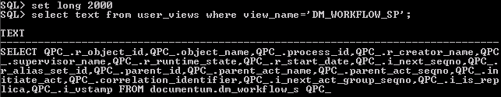
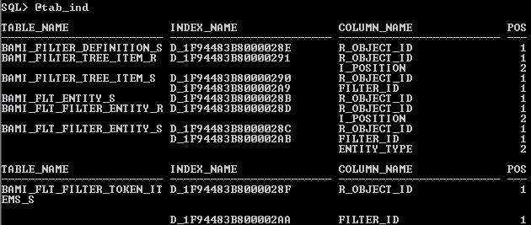
Identifying Available Indexes
Capture all of the tables that the view integrates
Run “tab_ind.sql” to generate the index list

Slide 19
Comparing the SARGs with Available Indexes
TABLE_NAME INDEX_NAME COLUMN_NAME POS
------------------------ ------------------------ ------------------------ ---
DM_WORKFLOW_R D_1F94483B8000018C R_OBJECT_ID 1
D_1F94483B8000018C I_POSITION 2
DM_WORKFLOW_S D_1F94483B8000018B R_OBJECT_ID 1
DM_XFM_FORM_S D_1F94483B800002F1 R_OBJECT_ID 1
select…
from dmi_workitem_sp w, dm_workflow_sp wf
where (
w.r_runtime_state in (0, 1, 3, 4, 5, 6)
and wf.r_runtime_state in (1, 3)
and (w.a_wq_name in (
select all w.wq_name from dmc_workqueue_sp w, dmc_workqueue_policy_sp p
where ((w.wq_policy_id=p.r_object_id)) ))
and (w.r_workflow_id=wf.r_object_id)
)

Slide 20
Test yourself: When can indexes be used?
Which queries will use an index on dm_sysobject_s(object_name,title)?
select title from dm_sysobject_s where object_name = ‘testdoc’
select object_name from dm_sysobject where title=‘A really good read’
select title from dm_sysobject_s where object_name like ‘%testdoc%’
select title from dm_sysobject_s where object_name like ‘testdoc%’
select title from dm_sysobject_s where object_name != ‘testdoc’
select title from dm_sysobject_s where object_name like ‘%testdoc’
select title from dm_sysobject_s where object_name in (‘testdoc’,’sampledoc’)
select title from dm_sysobject_s where UPPER(object_name) = UPPER(‘testdoc’)

Slide 21
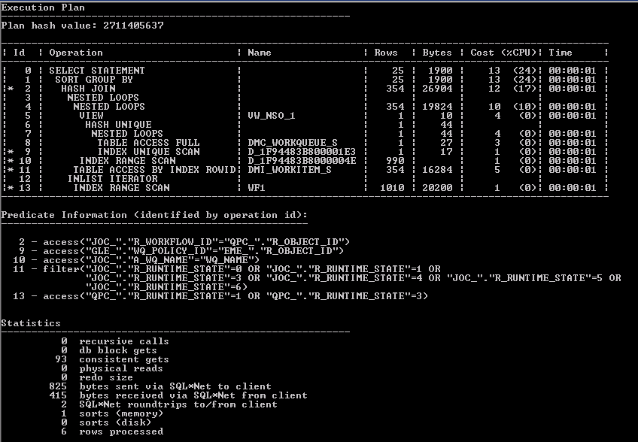
After adding an index on dm_workflow_s(r_runtime_state,r_object_id)

Slide 22
Choosing Useful Indexes
Good candidates include:
Column(s) used in the search arguments
Column(s) used for joins
Column(s) used in ORDER BY or GROUP BY operations
Should be selective
Should not be too wide
“Covering indexes” can greatly reduce logical reads, but should not contain too many columns
Watch out for:
Too many indexes on a table
Indexes on columns with data skew

Slide 23
How to create indexes
Indexes can be created directly in the RDBMS, or can be created from within Documentum
Indexes created in the RDBMS will not be “monitored” by Documentum
Indexes created on repeating valued attributes will affect query translation in different ways if they are created in the RDBMS vs. in Documentum
SQL
create index myindex on dmr_content_r(i_parked_state,r_object_id) tablespace DCTM_INDEX;
Documentum API:
apply,c,NULL,MAKE_INDEX,TYPE_NAME,S,dmr_content, ATTRIBUTE,S,i_parked_state,USE_ID_COL,B,T,ID_IN_FRONT,B,F
Documentum DQL:
EXECUTE make_index WITH type_name=‘dmr_content', attribute=‘i_parked_state‘,use_id_col=true

Slide 24
Indexes on Repeating Valued Attributes
Select r_object_id, object_name from dm_document where any keywords=‘repeating1’
No dmi_index on keywords:
select all dm_document.r_object_id, dm_document.object_name from dm_document_sp dm_document where ( exists (select r_object_id from dm_sysobject_r where dm_document.r_object_id = r_object_id and keywords='repeating1')) and (dm_document.i_has_folder = 1 and dm_document.i_is_deleted = 0)
With dmi_index on keywords:
select all dm_document.r_object_id, dm_document.object_name from dm_document_sp dm_document where (dm_document.r_object_id in (select r_object_id from dm_sysobject_r where keywords='repeating1')) and (dm_document.i_has_folder = 1 and dm_document.i_is_deleted = 0)

Slide 25
Monitoring index usage
Optimizer may choose to not use the indexes you’ve created
As each additional index adds overhead on insert, update and delete you should remove unnecessary indexes (custom only!)
To monitor an index for usage:
alter index MYINDEX monitoring usage;
To turn off monitoring:
alter index MYINDEX nomonitoring usage;
To check for usage
select index_name, monitoring, used, start_monitoring, end_monitoring
from v$object_usage
where index_name = ‘MYINDEX’
/

Slide 26
Collecting statistics
From Documentum using the dm_UpdateStatistics job
Runs once a week by default
Prior to 6.5 SP1 it used “analyze”, now it uses DBMS_STATS.GATHER_TABLE_STATS
WARNING: if it fails on one table, the whole job aborts!
From Oracle using DBMS_STATS
Syntax:
EXEC DBMS_STATS.GATHER_SCHEMA_STATS( -
ownname => NULL, -
options => 'GATHER', -
granularity => ‘AUTO', -
cascade => TRUE, -
method_opt => 'for all columns size AUTO' -
);

Slide 27
Collecting histograms on data in a column
EXEC DBMS_STATS.GATHER_TABLE_STATS (-
ownname => user, -
tabname=> ‘TABLE_NAME', -
cascade => true, -
estimate_percent => 100, -
method_opt => 'for columns size NUM_BUCKETS COLUMN_NAME ‘
);

Slide 28
SQL Server Query Tuning
Viewing the estimated or actual execution plan in SSMS
Identifying available indexes
Getting IO and Timing statistics
Viewing statistic and histogram data for an index
Covering indexes and included columns
Viewing and repairing index fragmentation

Slide 29
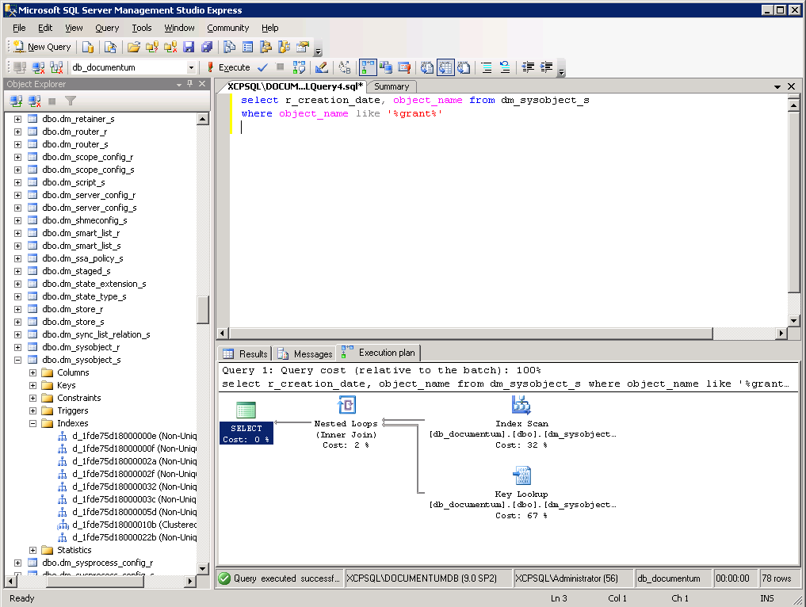
Getting an execution plan in SQL Server
Actual execution plan
Estimated execution plan
Plan can be exported to an XML file

Slide 30
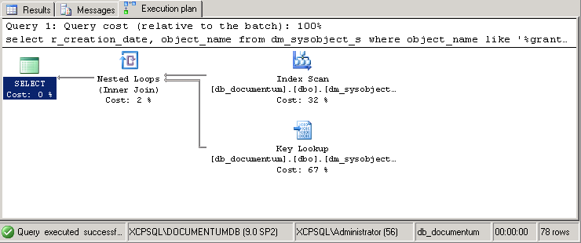

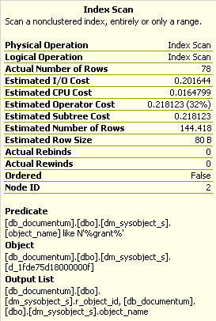

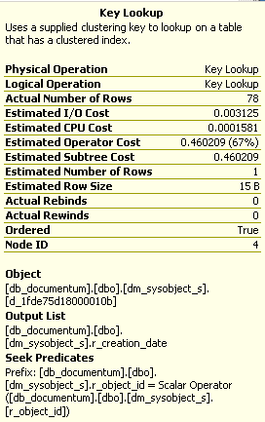


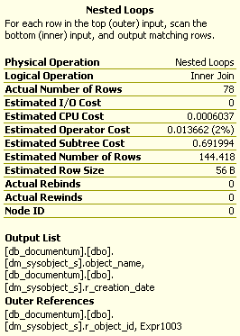
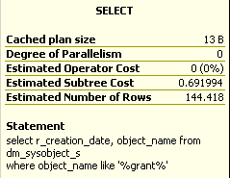
Execution plan details

Slide 31
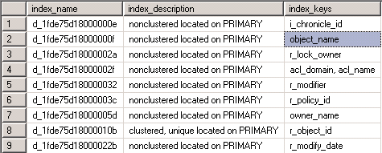
Listing all indexes on a table
sp_helpindex ‘table_name’

Slide 32
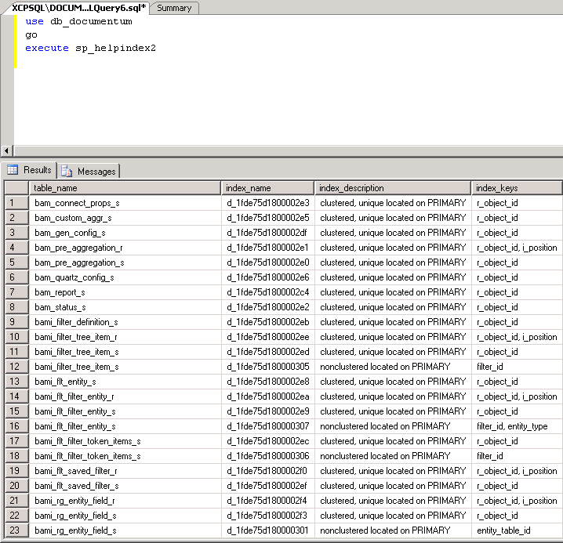
Listing all indexes in a SQL Server database
Import the sp_helpindex2 stored procedure to quickly list all indexes in a database

Slide 33
“set statistics time on” & “set statistics io on”
SQL Server parse and compile time:
CPU time = 0 ms, elapsed time = 1 ms.
-----------
14869
(1 row(s) affected)
Table 'dm_sysobject_s'. Scan count 1, logical reads 183, physical reads 0, read-ahead reads 0, lob logical reads 0, lob physical reads 0, lob read-ahead reads 0.
SQL Server Execution Times:
CPU time = 0 ms, elapsed time = 8 ms.

Slide 34
Covering Indexes
A covering index is one that includes all columns in the query
Columns can be added as key values, or included as non-key values (SQL Server only)
Key values are stored at all levels of the index
Included columns are only stored in the leaf nodes
Covering indexes reduce I/O by avoiding table lookups
create index sysobj_cover
ON dm_sysobject_s( r_object_type,i_is_deleted, i_has_folder,a_content_type)
INCLUDE (r_object_id,object_name,owner_name,acl_domain,acl_name)

Slide 35
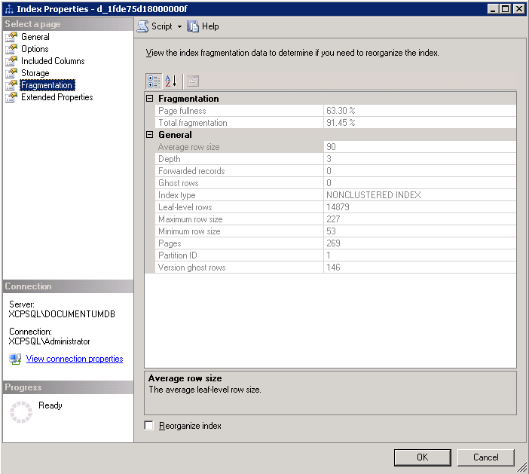
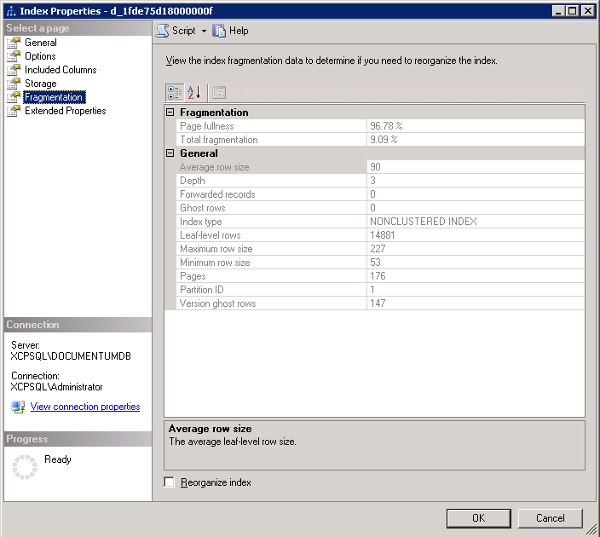
Displaying and Fixing Index Fragmentation
The fuller the page, the more rows can be read in a single page read.
Fewer pages means less I/O

Slide 36
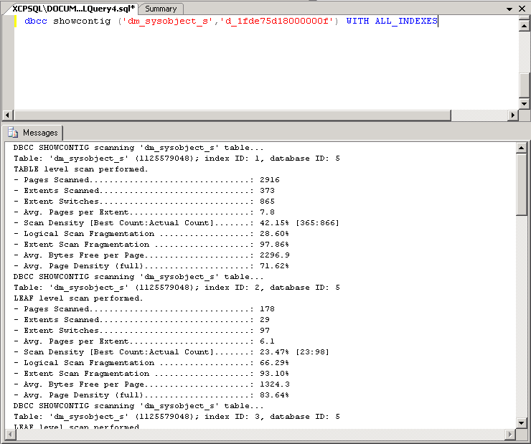
“dbcc showcontig” output
NOTE:
dm_UpdateStatistics job has a –dbreindex option
READ
Calculate the fragmentation statistics only
FIX
Rebuild the indexes to reduce fragmentation
FIX should be run at regular intervals to ensure optimal database I/O performance

Slide 37
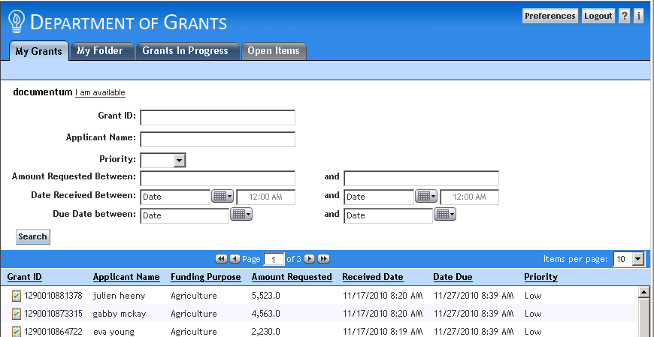
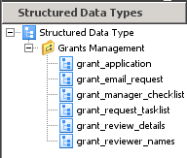
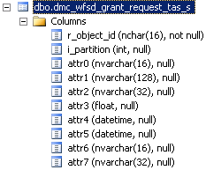
Optimizing Searches and Filtering on SDT Values
SDTs are not indexed by default, so searches and filtering will be slow.
SDTs are stored differently in the database, so identifying the correct columns to index is a little trickier.

Slide 38
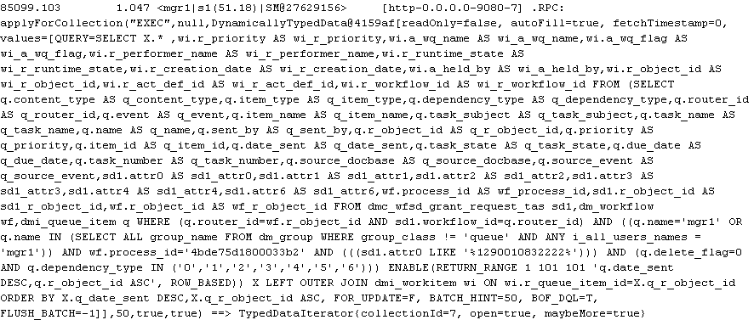
Identifying SDT Queries

Slide 39
Recap
Overview of query execution concepts
Obtaining SQL from DQL
Obtaining and influencing the execution plan in Oracle
Obtaining and influencing the execution plan in SQL Server
Identifying and indexing key SDT data

Slide 40

Q&A

